Slide 1
Tarot Card Key
Zachary Merrill
IT 315

Slide 2
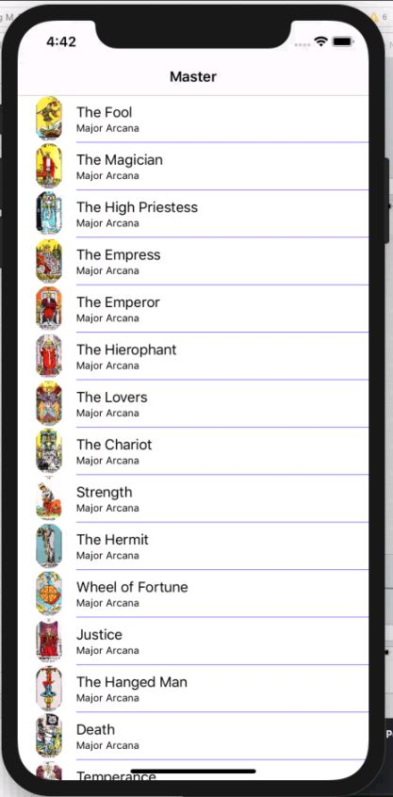
Tarot Card Key
The app is designed to help learn each tarot in order including both the major and minor arcana sets of cards.
The app has two views
Master view that takes in JSON data to show each cards picture, name, and set.
Detailed view of whichever tarot selected which depicts the name, image, set, and fortune.

Slide 3
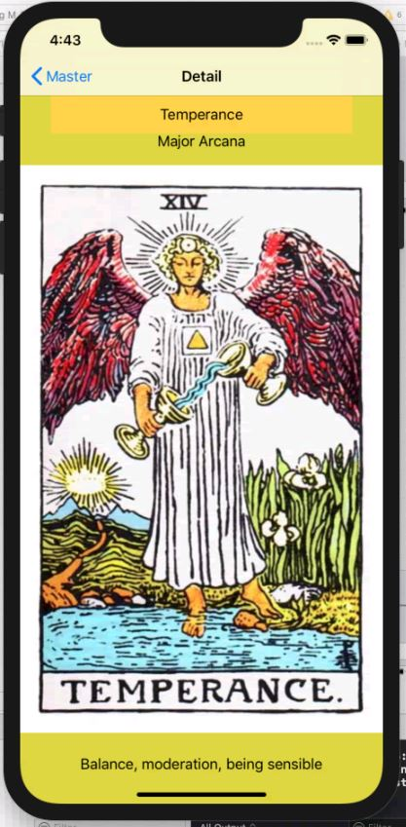
Target Audience
Those who are interested in forms of fortune telling, and interested in learning about one of the oldest and interesting systems of fortune telling.

Slide 4
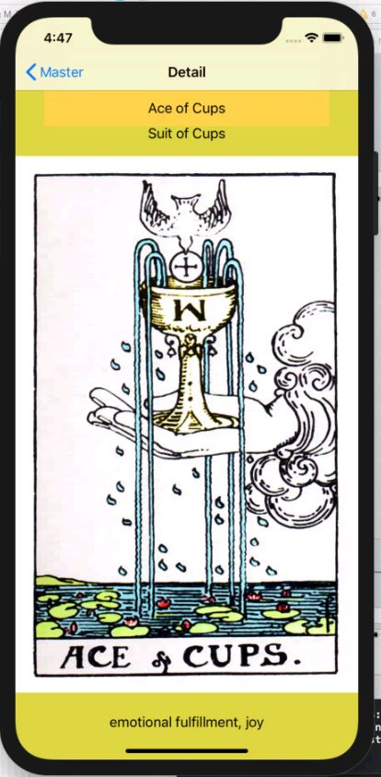
Key Concepts
Views
JSON Data
Segues
Swift functions

Slide 5
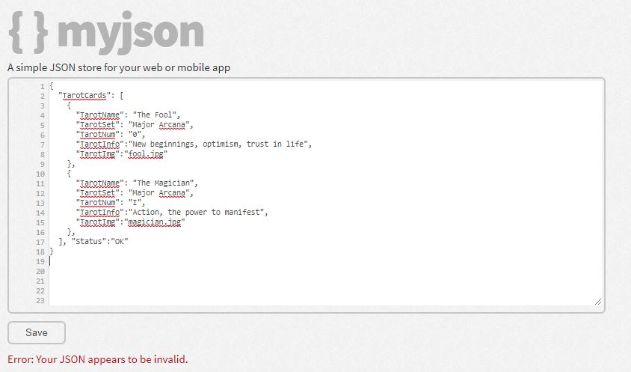
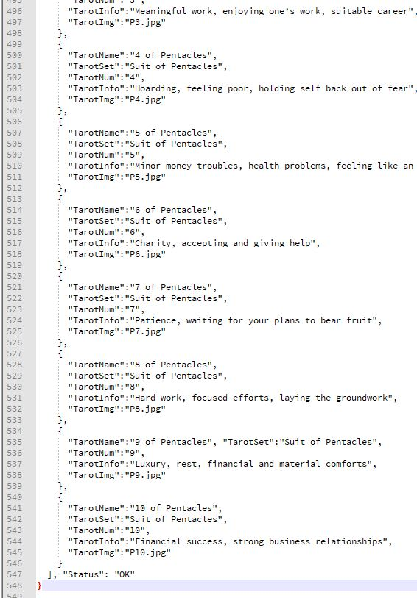
Challenges Faced
Amount of time it took to create JSON data
Had to hard code around 550 lines of JSON for all the tarots
Issues with JSON syntax
Had issues with formatting it to read in MyJSON
Had to use validator
Couldn’t remember how to build views correctly so had to work out of hiking trails to implement the JSON data in the master view without errors.

Slide 6
Next Step
100 Days
Create more functionality like a working segue to link
Create from scratch without using previous project as guidance
300 Days
Create some sort of fortune game to implement
Add fun facts about tarots, such as media that uses them

